Slide 1
Android Application Success Prediction and Review Analysis
Based On Research Paper
Presented By: Rituraj Saha¹, Ritam Barik¹ , Pranav Jain¹

Slide 2
Contents
Abstract
Introduction
Literature Review
Methodology
Comparison and Results
Conclusion
Objective
Research Goal

Slide 3
Abstract
Machine Learning plays an important role in computer technology and artificial intelligence. It can reduce human effort in prediction, learning, and recognition.
In this paper, data analysis was accomplished using various machine learning algorithms on a smaller scale to dive deeper into the Google playstore data records to discover the apps that are more likely to be successful.
The accomplishment of an app is anticipated soon after it's miles launched into the Google play store.

Slide 4
Introduction
The research companies adeven, distimo and localytics found more than 60% of applications in the app store have never been downloaded in 2012 and 80% of paid android apps got less than 100 downloads in 2011, and nearly 80% of all app users across all industries dropped an app within 90 days in 2017, with 25% of them using it only once.
App creators, therefore consequently should understand their customers’ needs to make sure their applications get a better response as soon as deployed into an app store.
Moreover, evidence has also shown that ratings and installs are often highly linked and that android app rating is one of the main determinants in consumers’ app downloading decision.

Slide 5
Objective
To visualize the relationship between different attributes of an android app in order to conclude the correlation between them. Additionally, an analysis of the features such as App Name, Content Rating and Type was done to reach some valid conclusion.
To determine the standard of an app by the number of installs and user ratings it has received over its lifetime rather than the revenue it generates.
To determine which feature needs to be maintained or updated depending upon the current state of the application.

Slide 6
Research Goal
Original motive for this study was to find something significant throughout the exploration that could make a difference to the developers or end users.
To introduce machine learning applications to developers so that they can find the ways to reach the right people with the right apps.
To help developers predict whether their app will be successful in the long run after launching it into the Google playstore.

Slide 7
Methods and Data Collection
A dataset was collected having about 10,000 apps with various attributes like category, rating, size, number of installs etc., along with another dataset having 64,000 reviews.
Data processing part included replacing of null values with the mean of their respective attribute, changing the attribute type and encoding of categorical attributes.
Further, to find out the sentiment of the users, the review text was processed using Bag of Words model. Sentiment of each of the reviews were label encoded from Positive, Neutral and Negative to 0,1 and 2 respectively.

Slide 8
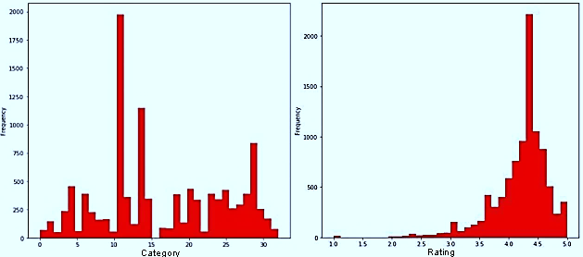

Frequency vs Category
Frequency vs Rating

Slide 9
Various regression algorithms such as KNN, Random Forest, Multiple linear Regressor and SVM were used in-order to predict the rating of the apps depending on their features.
The relationship between various attributes of an app was analyzed with the help of K Means and Hierarchical Clustering models.
Bag of Words model was used in Natural Language Processing to preprocess the data which was then classified using Logistic Regression Classification to predict the sentiment of the users’ review.

Slide 10
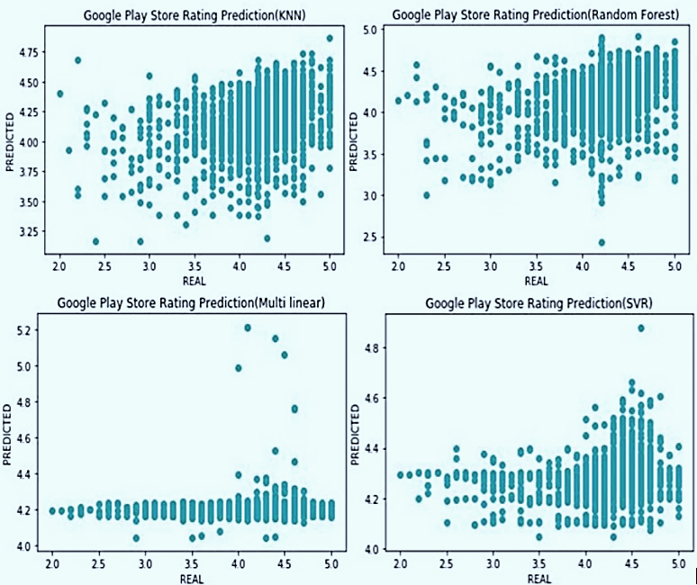
Comparison and Results
Visual representation
Regression Model | MSE | R2 Score | MSL
KNN | 0.1691 | 0.1126 | 0.0073
Random Forest | 0.1760 | 0.0768 | 0.0076
MLR | 0.1900 | -0.0016 | 0.0082
SVM | 0.1875 | 0.0160 | 0.0082
Comparison between various regression models

Slide 11
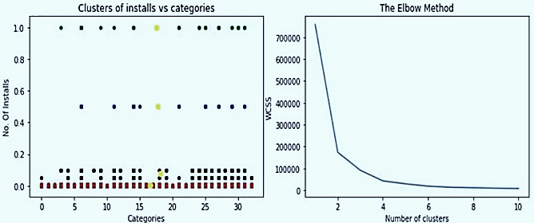
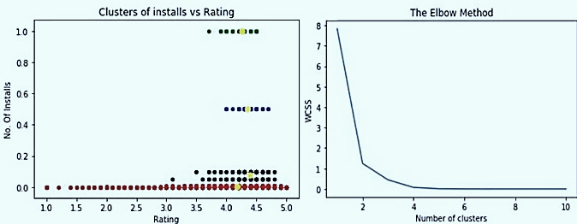
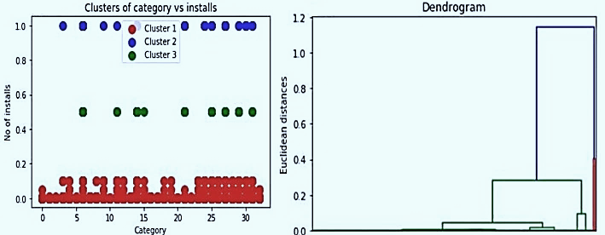
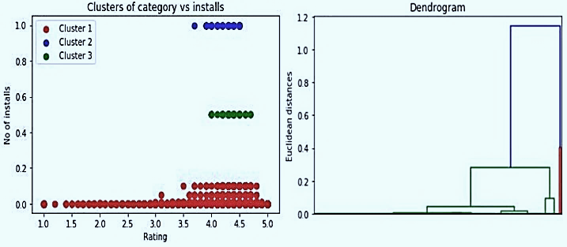
K Means Clustering
Hierarchical Clustering

Slide 12
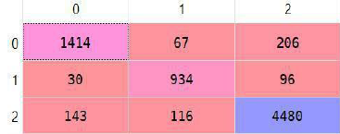
Confusion Matrix
Accuracy Score | R2 Score | Precision | Recall | F Score
0.91210 | 0.67095 | 0.91225 | 0.91210 | 0.9190
Classification Table
Logistic Regression Classification

Slide 13
Conclusion
The result indicates that app ratings are highly predictable from the claims developers made about their features.
The combination of apps’ features extraction and machine learning allowed to predict the rating of Google Playstore apps with 83.09% accuracy using K Nearest Neighbor Regression.
The relation between different features of an app using various clustering models of machine learning was also analyzed.
The successful prediction of the sentiment of the users with 91.2% accuracy was also made using Natural Language Processing and Logistic Regression Classification model.

Slide 14
THANK YOU

